Slide 1


Innovation at Speed
Adrian Cockcroft
AWS VP Cloud Architecture Strategy

Slide 2
OLD WORLD
TRAVEL IT
Marketing analytics
Employees at work
Travel Agents
Operations and Maintenance

Slide 3

NEW WORLD TRAVEL IT
OLD WORLD
TRAVEL IT
Marketing analytics
Employees at work
Travel Agents
Operations and Maintenance

Slide 4


Mobile employees
NEW WORLD TRAVEL IT
Employees at work
Online marketing
Continuous operations and maintenance tracking
Social media
Operations
and maintenance
Online direct
travel bookings
Routing optimization
IoT connected things;
baggage tracking, etc.
Aggregators

Slide 5
Personalization
Customer analytics
New channels direct to customer
More things, more scale, rapid change
New Needs
Notes:
Education example
New World: Product is interactive online content, customer is end user. Result is a personal learning plan. Engagement and retention
New Needs: Personalization, customer tracking, new channels direct to consumer by passing existing institutions

Slide 6
AWS: Unblocking Innovation for Digital Transformation Across
the Travel Industry

Slide 7
Blockers for Innovation
Culture
Skills
Organization
Finance
Leadership Systems and Feedback
Training and Compensation
Silos Project to Product
CapEx
Versus OpEx

Slide 8
Blockers for Innovation
Culture
Leadership Systems and Feedback
Centralized slow decision making
Lack of trust
Inflexible policies and processes
Skills
Organization
Finance
Training and Compensation
Silos Project to Product
CapEx
Versus OpEx

Slide 9
Blockers for Innovation
Culture
Leadership Systems and Feedback
Stephen Orban
Ahead in the Cloud
Mark Schwartz
A Seat at the Table
Skills
Organization
Finance
Training and Compensation
Silos Project to Product
CapEx
Versus OpEx

Slide 10

Culture
“If you want to build a ship, don’t drum up the people to gather wood, divide the work, and give orders. Instead, teach them to yearn for the vast and endless sea.”
Antoine de Saint-Exupéry, author of “Le Petit Prince” (“The Little Prince”)

Slide 11
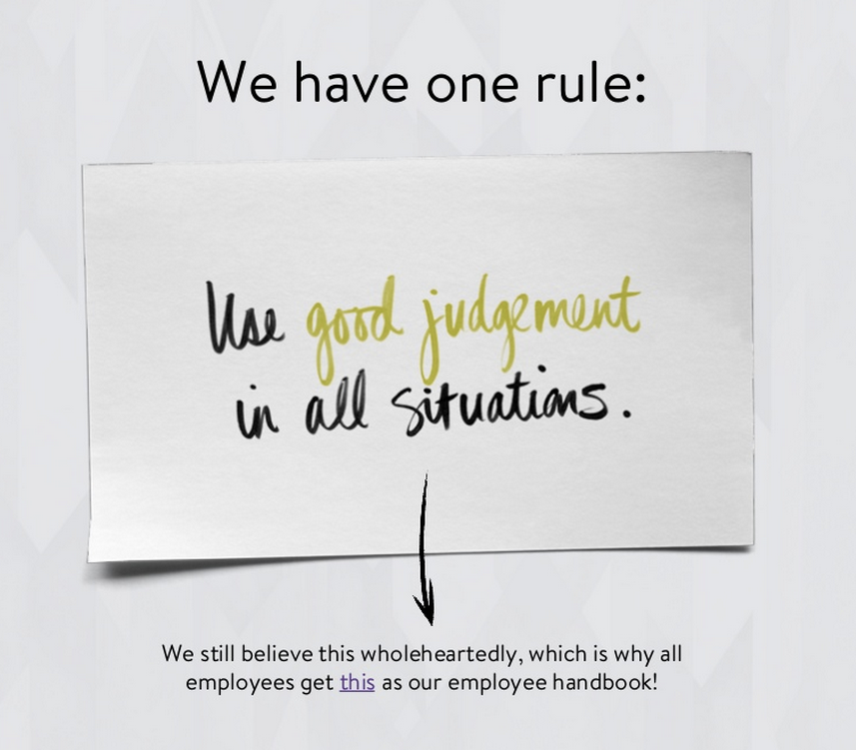

Culture
Nordstrom Technology NorDNA Culture Deck

Slide 12

Values are what we value
High performance
Freedom & responsibility
Context, not control
Highly aligned, loosely coupled
Pay top of market
Promotions & development
Culture
Seven Aspects of Netflix Culture

Slide 13

Customer obsession
Ownership
Invent and simplify
Are right, a lot
Hire and develop the best
Insist on the highest standards
Think big
Bias for action
Frugality
Learn and be curious
Earn trust of others
Dive deep
Have backbone; disagree and commit
Deliver results
Culture
Amazon leadership principles

Slide 14
Intentional
Appropriate
Judgement
Skills
Organization
Finance
Culture
Training and Compensation
Silos Project to Product
CapEx
Versus OpEx

Slide 15
Blockers for Innovation
Culture
Skills
Organization
Finance
Leadership Systems and Feedback
Training and Compensation
Silos Project to Product
CapEx
Versus OpEx
Centralized decision making
Lack of trust
Inflexible policies and processes

Slide 16
Blockers for Innovation
Skills
Training and Compensation
Train existing staff on cloud tech
Fund pathfinder teams
Create incentives to keep the best people after training!
Culture
Organization
Finance
Leadership Systems and Feedback
Silos Project to Product
CapEx
Versus OpEx

Slide 17
Blockers for Innovation
Skills
Training and Compensation
Get out of the way of innovation
Read Powerful
by Patty McCord
Netflix Chief Talent Officer
Culture
Organization
Finance
Leadership Systems and Feedback
Silos Project to Product
CapEx
Versus OpEx

Slide 18
Blockers for Innovation
Culture
Skills
Organization
Finance
Leadership Systems and Feedback
Training and Compensation
Silos Project to Product
CapEx
Versus OpEx
Train existing staff on cloud tech
Fund pathfinder teams
Be prepared to pay more to keep the best people after training!

Slide 19
Blockers for Innovation
Organization
Move from Projects to Product Teams
Long term product ownership
Continuous delivery
DevOps and “run what you wrote”
Reduces tech-debt and lock-in
Culture
Skills
Finance
Leadership Systems and Feedback
Training and Compensation
CapEx
Versus OpEx
Silos Project to Product

Slide 20

Blockers for Innovation
Organization
Move from Projects to Product Teams
Project to Product
by Mik Kersten
The DevOps
Handbook
by Gene Kim et. al.
Culture
Skills
Finance
Leadership Systems and Feedback
Training and Compensation
CapEx
Versus OpEx
Silos Project to Product

Slide 21
Blockers for Innovation
Culture
Skills
Organization
Finance
Leadership Systems and Feedback
Training and Compensation
Silos Project to Product
CapEx
Versus OpEx

Slide 22
Blockers for Innovation
Finance
CapEx Versus OpEx
Is your CTO defining your technology architecture or is the CFO really in charge?
Culture
Skills
Organization
Leadership Systems and Feedback
Training and Compensation
Silos Project to Product

Slide 23
Blockers for Innovation
Finance
CapEx Versus OpEx
Datacenter to Cloud
Waterfall to Agile and DevOps
Understand the impact on EBITDA
Plan ahead, don’t surprise the CFO or your shareholders
Culture
Skills
Organization
Leadership Systems and Feedback
Training and Compensation
Silos Project to Product

Slide 24
Pathway for Digital Transformation
Speed
Scale
Strategic
!
Time to Value
Distributed Optimized Capacity
Critical Workloads Datacenter Replacement

Slide 25

Pathway for Digital Transformation
Speed
Scale
Strategic
Time to Value
The fast companies are
440x
faster than the slow
We found that, compared to low performers, high performers have:
46 times more frequent code deployments
440 times faster lead time from commit to deploy
170 times faster mean time to recover from downtime
5.0 times lower change failure rate (1/5 as likely for a change to fail)
!
Months
Hours
Distributed Optimized Capacity
Critical Workloads Datacenter Replacement
https://itrevolution.com/book/accelerate/

Slide 26
Time to Value (2018 DORA Report)
The elite companies are
2,555x
faster than the slow
We found that, compared to low performers, high performers have:
46 times more frequent code deployments
2,555 times faster lead time from commit to deploy
2,604 times faster mean time to recover from downtime
7 times lower change failure rate (1/7 as likely for a change to fail)
The elite are moving further ahead…
https://itrevolution.com/book/accelerate/

Slide 27
Time to Value
Learn to do simple things quickly to unblock innovation
Avoid complex one-size-fits-all processes

Slide 28
Pathway for Digital Transformation
Speed
Scale
Strategic
Time to Value
The best IT architecture today is:
Minimalist, messy and inconsistent
Provides guard rails for security, scalability and availability
Designed to evolve rapidly and explore new technologies
Supports low latency continuous delivery
!
Distributed Optimized Capacity
Critical Workloads Datacenter Replacement

Slide 29
Pathway for Digital Transformation
Speed
Scale
Strategic
!
Time to Value
Distributed Optimized Capacity
Critical Workloads Datacenter Replacement

Slide 30
Pathway for Digital Transformation
Speed
Scale
Strategic
Distributed Optimized Capacity
Highly Scaled
Distributed for Availability
Cost Optimized High Utilization
Cloud Native Architecture
!
Time to Value
Critical Workloads Datacenter Replacement

Slide 31
Cloud Native Principles
Pay as you go, afterwards
Self service—no waiting
Globally distributed by default
Cross-zone/region availability models
High utilization—turn idle resources off
Immutable code deployments

Slide 32


Cloud Native Applications
Qantas Constellation flight route planning
EasyJet Scaling to peak demand: 900K bookings/hour
!
Time to Value
Critical Workloads Datacenter Replacement
Notes:
Qantas
The leading carrier in Australia is making a very significant use of AWS to retire its technical debt, and develop project such as Constellation. Constellation is a flight planning system built by Qantas in conjunction with the university of Sydney, running on AWS, that allows aircraft to optimize route planning, producing savings on fuel consumption.

Slide 33
Pathway for Digital Transformation
Speed
Scale
Strategic
!
Time to Value
Distributed Optimized Capacity
Critical Workloads Datacenter Replacement

Slide 34


Close all 20 data centers by 2023
Our Strategic Goals with AWS
80% of all customer interaction enhanced by AI
Train 100% of engineers on AWS platform
Time to Value
Distributed Optimized Capacity
Notes:
TUI
World's largest Tour Operator. They are going "all-in" with AWS. Working with AWS to accelerate its digital transformation and deliver personalized travel experiences.
https://aws.amazon.com/solutions/case-studies/tui/

Slide 35


130 staff trained
27 environments
379 EC2 instances
1 second billing
First migration of €5.8b selling platform completed
39 load balancers
95 security groups
~230k lines of code (70% re-usable)
97% to ~99.99 % Infrastructure availability
by
Notes:
Our first migration was the heart of our North Europe Business
Using the AWS Cloud Adoption Framework, we migrated the heart of our business, our selling platform responsible for our €5.8 billion in sales while also building a Landing Zone for the all countries to migrate using a single standard.
We trained 130 staff on AWS skills.

Slide 36
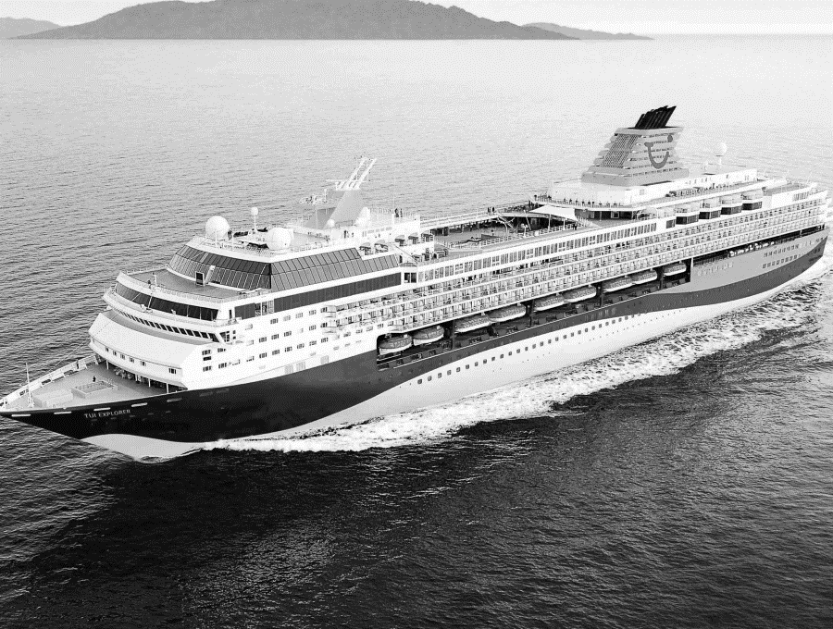
AWS Cloud Migration to Follow
600 applications
22,000 cores compute power
720 hardware servers
3,150TB storage
2500 Virtual Servers
550 databases
Notes:
TUI is All-In on AWS and have a large program across multiple countries to migrate out of our data centres but also re-enigeer for the cloud.

Slide 37


All-in Customers

Slide 38
Datacenter to cloud migrations are under-way for the most business and safety critical workloads
AWS and our partners are developing patterns, solutions and services for customers in all industries including travel, finance, healthcare, manufacturing…

Slide 39
Do you have a backup datacenter?
How often do you failover apps to it?
How often do you failover the whole datacenter at once?
“Availability Theater”

Slide 40
A fairy tale…
Once upon a time, in theory, if everything works perfectly, we have a plan to survive the disasters we thought of in advance.
How did that work out?

Slide 41
Forgot to renew domain name…
SaaS vendor
Entertainment site
Didn’t update security certificate and it expired…
Datacenter flooded in hurricane Sandy…
Finance company, Jersey City
Whoops!
YOU, tomorrow

Slide 42
“You can’t legislate against failure, focus on fast detection and response.”
—Chris Pinkham

Slide 43

The Network Is Reliable ACM Queue 2014
Bailis & Kingsbury
@pbailis @aphyr
(Spoiler—it isn’t…)

Slide 44
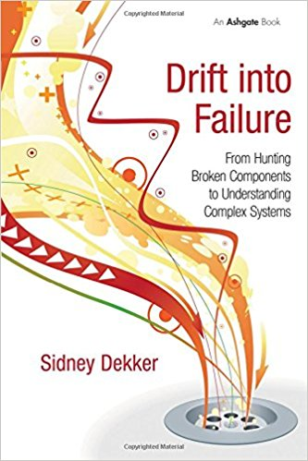
Drift Into Failure
Sydney Dekker
Everyone can do everything right at every step, and you may still get a catastrophic failure as a result…

Slide 45
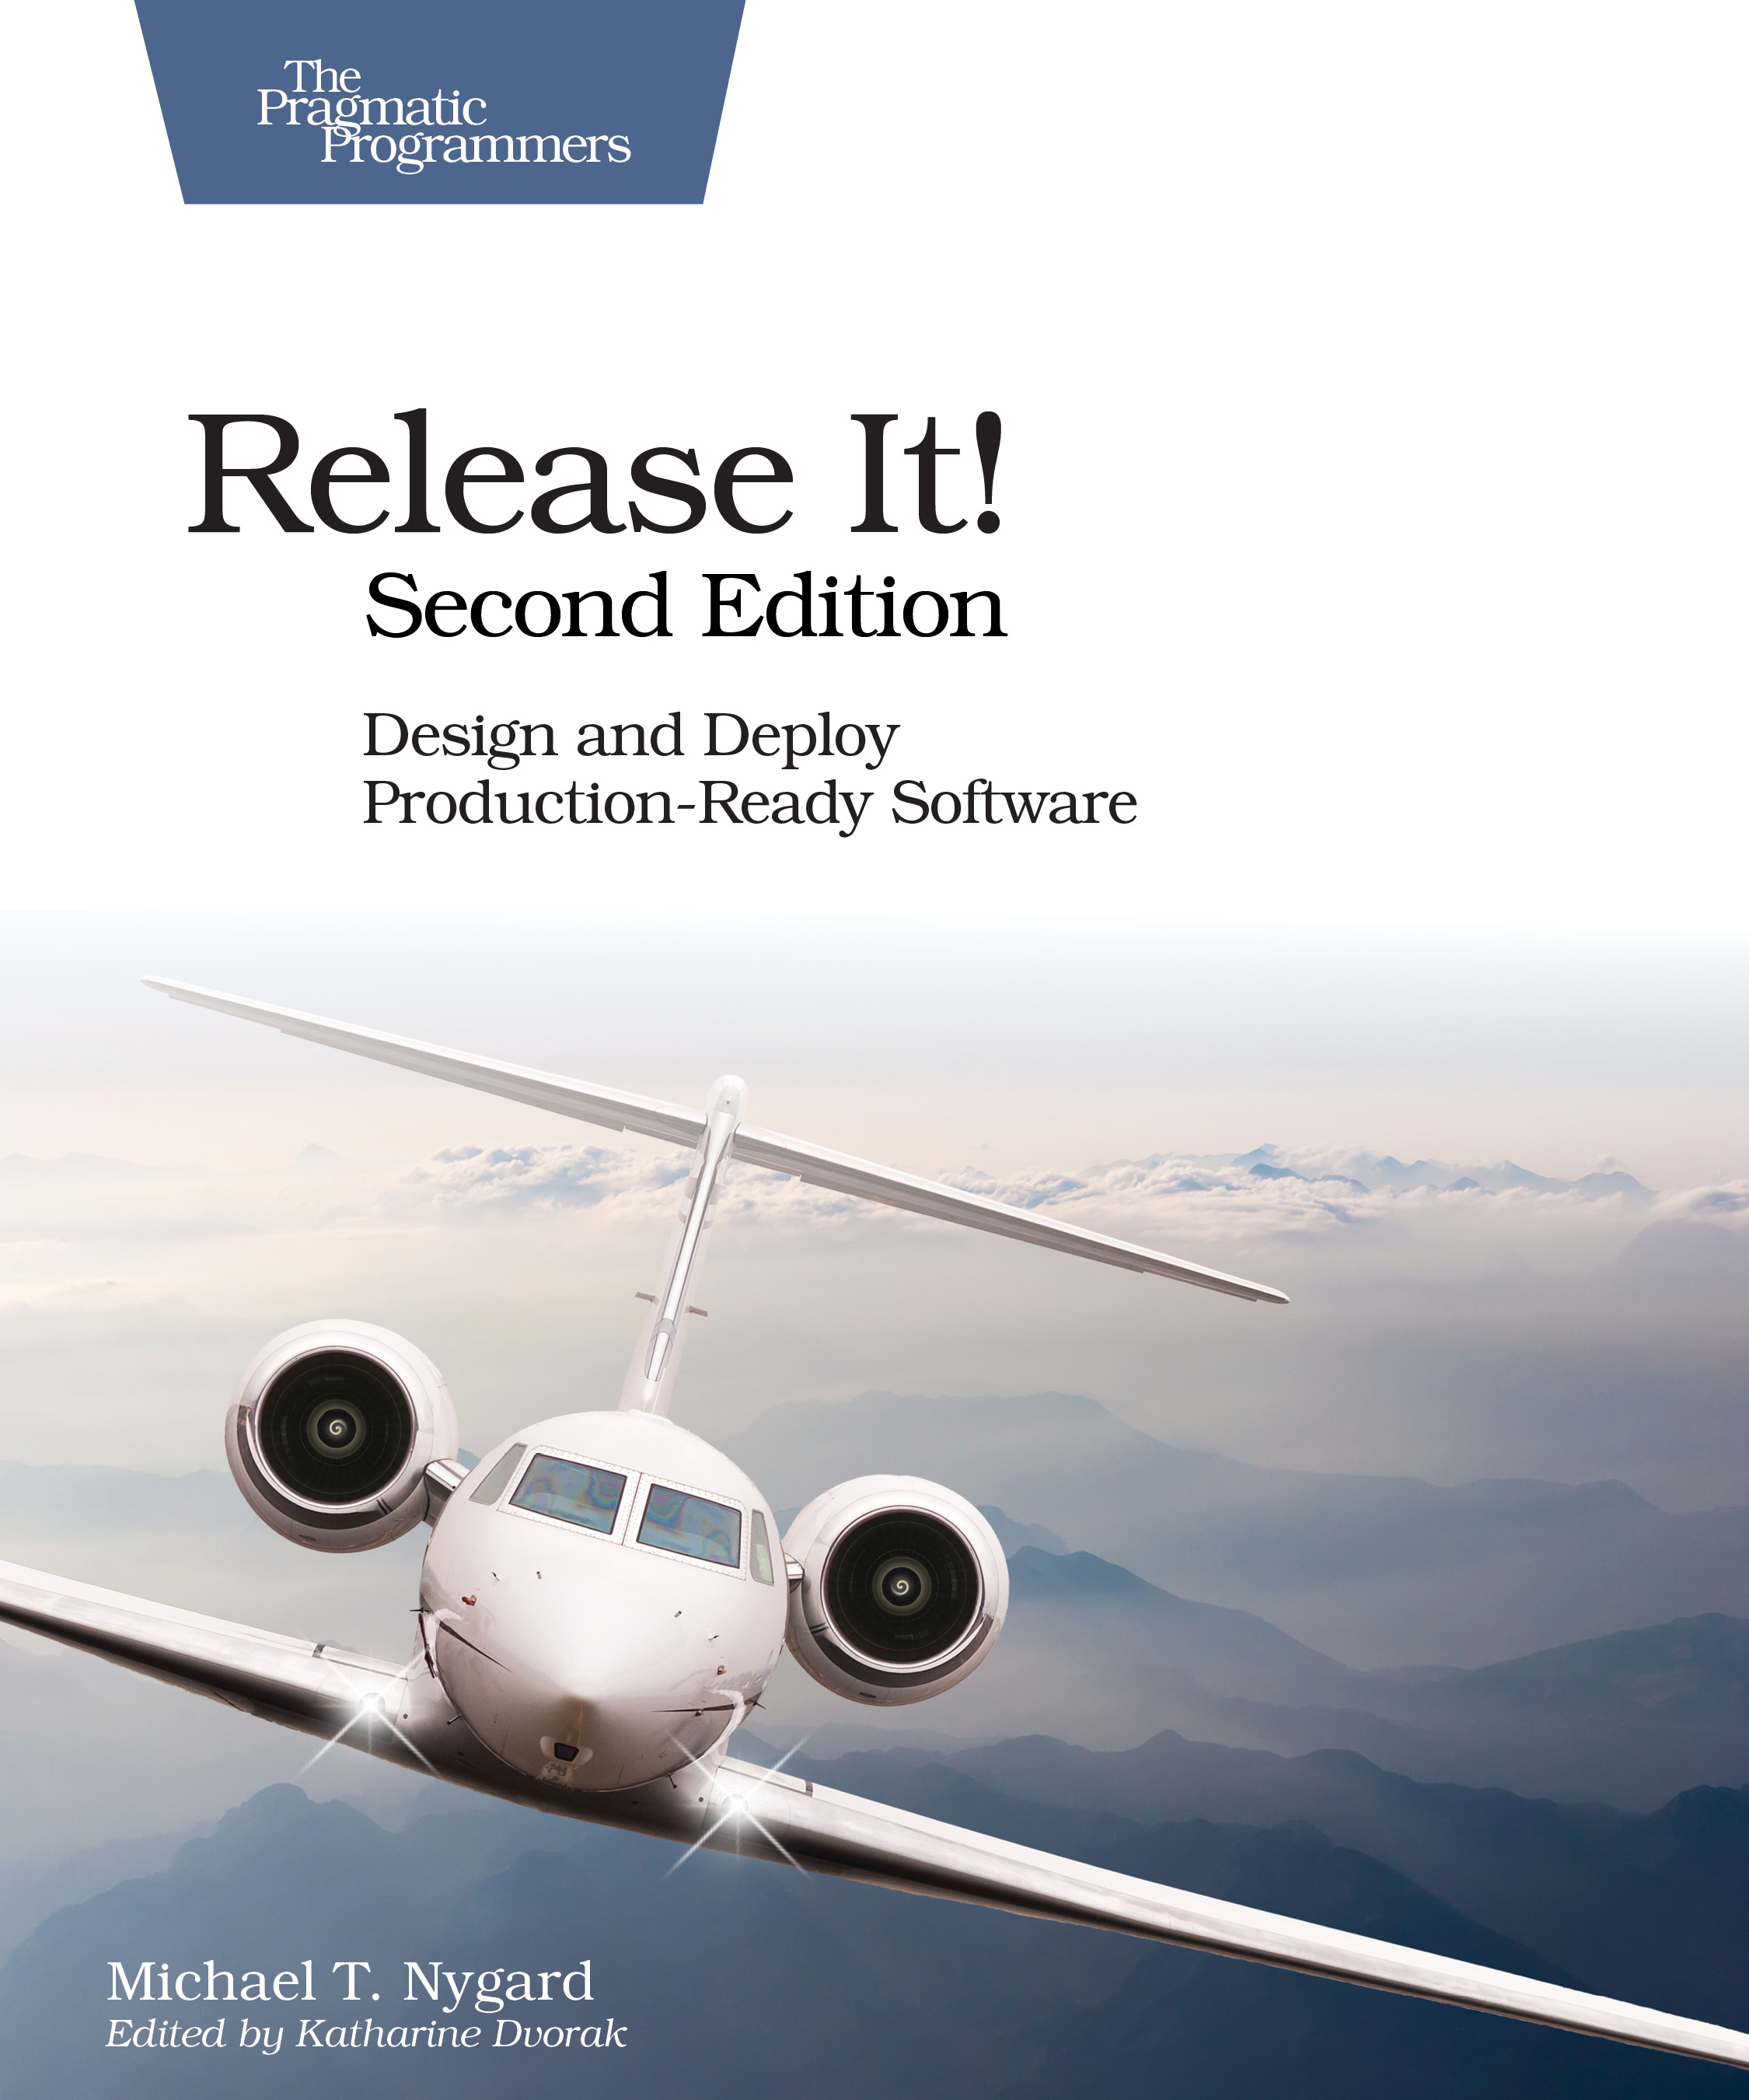
Release It! Second Edition 2017
Michael Nygard
Bulkheads, circuit breakers, and some new ideas…

Slide 46
Resilience
Past
Present
Future
?
Disaster recovery
Chaos engineering
Resilient
critical systems

Slide 47
Resilience
2004
2010
2012
2016
2017
2018
2004
Amazon—Jesse Robbins. Master of disaster
2010
Netflix—Greg Orzell. @chaosimia—First implementation of Chaos Monkey to enforce use of auto-scaled stateless services
2012
NetflixOSS open sources simian army
2016
Gremlin Inc founded
Chaos engineering
2017
Netflix chaos eng book. Chaos toolkit open source project
2018
Chaos concepts getting adoption, more startups

Slide 48
Chaos architecture
Four layers
Two teams
An attitude

Slide 49

People
Application
Chaos Engineering Team
Switching
Infrastructure

Slide 50
Chaos
architecture
People
Application
Four layers
Two teams
An attitude— Find the weakest link
Tools
Tools
Chaos Engineering Team
Switching
Security Red Team
Infrastructure

Slide 51
You can only be as strong as your weakest link
Dedicated teams are needed to find weaknesses before they take you out!

Slide 52
Failures are a system problem— lack of safety margin
Not something with a root cause of component or human error

Slide 53
Experienced staff
Robust applications
Dependable switching fabric
Redundant service foundation

Slide 54
Cloud provides the automation that leads to chaos engineering

Slide 55
As datacenters migrate to cloud, fragile and manual disaster recovery processes can be standardized and automated

Slide 56

Testing failure mitigation will move from a scary annual experience to automated continuously tested resilience
Time to Value
Distributed Optimized Capacity

Slide 57
One more thing…
Speed
Scale
Strategic
!
Time to Value
Distributed Optimized Capacity
Critical Workloads Datacenter Replacement

Slide 58
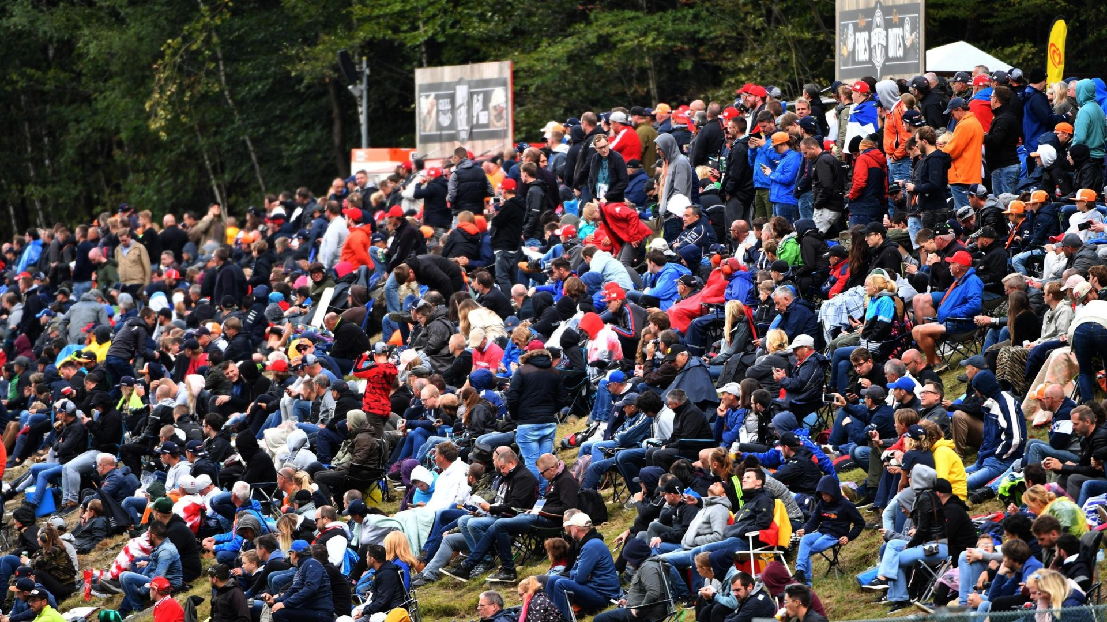
Globally, over 500 million fans watch F1 each year (and many travel to the races…)

Slide 59
Amongst the most watched sports in the world.

Slide 60
https://aws.amazon.com/solutions/case-studies/formula-one/
To accelerate its cloud transformation, Formula 1 is moving the vast majority of its infrastructure from on-premises data centers to AWS and standardizing on AWS’s machine-learning and data-analytics services
Formula 1 will work with AWS to enhance:
Race strategies
Data tracking systems
Broadcast insights
Through a wide variety of AWS services:
Amazon SageMaker
AWS Lambda
AWS’s event-driven serverless computing service
AWS analytics services
To deliver new race metrics that will change the way fans and teams experience racing

Slide 61
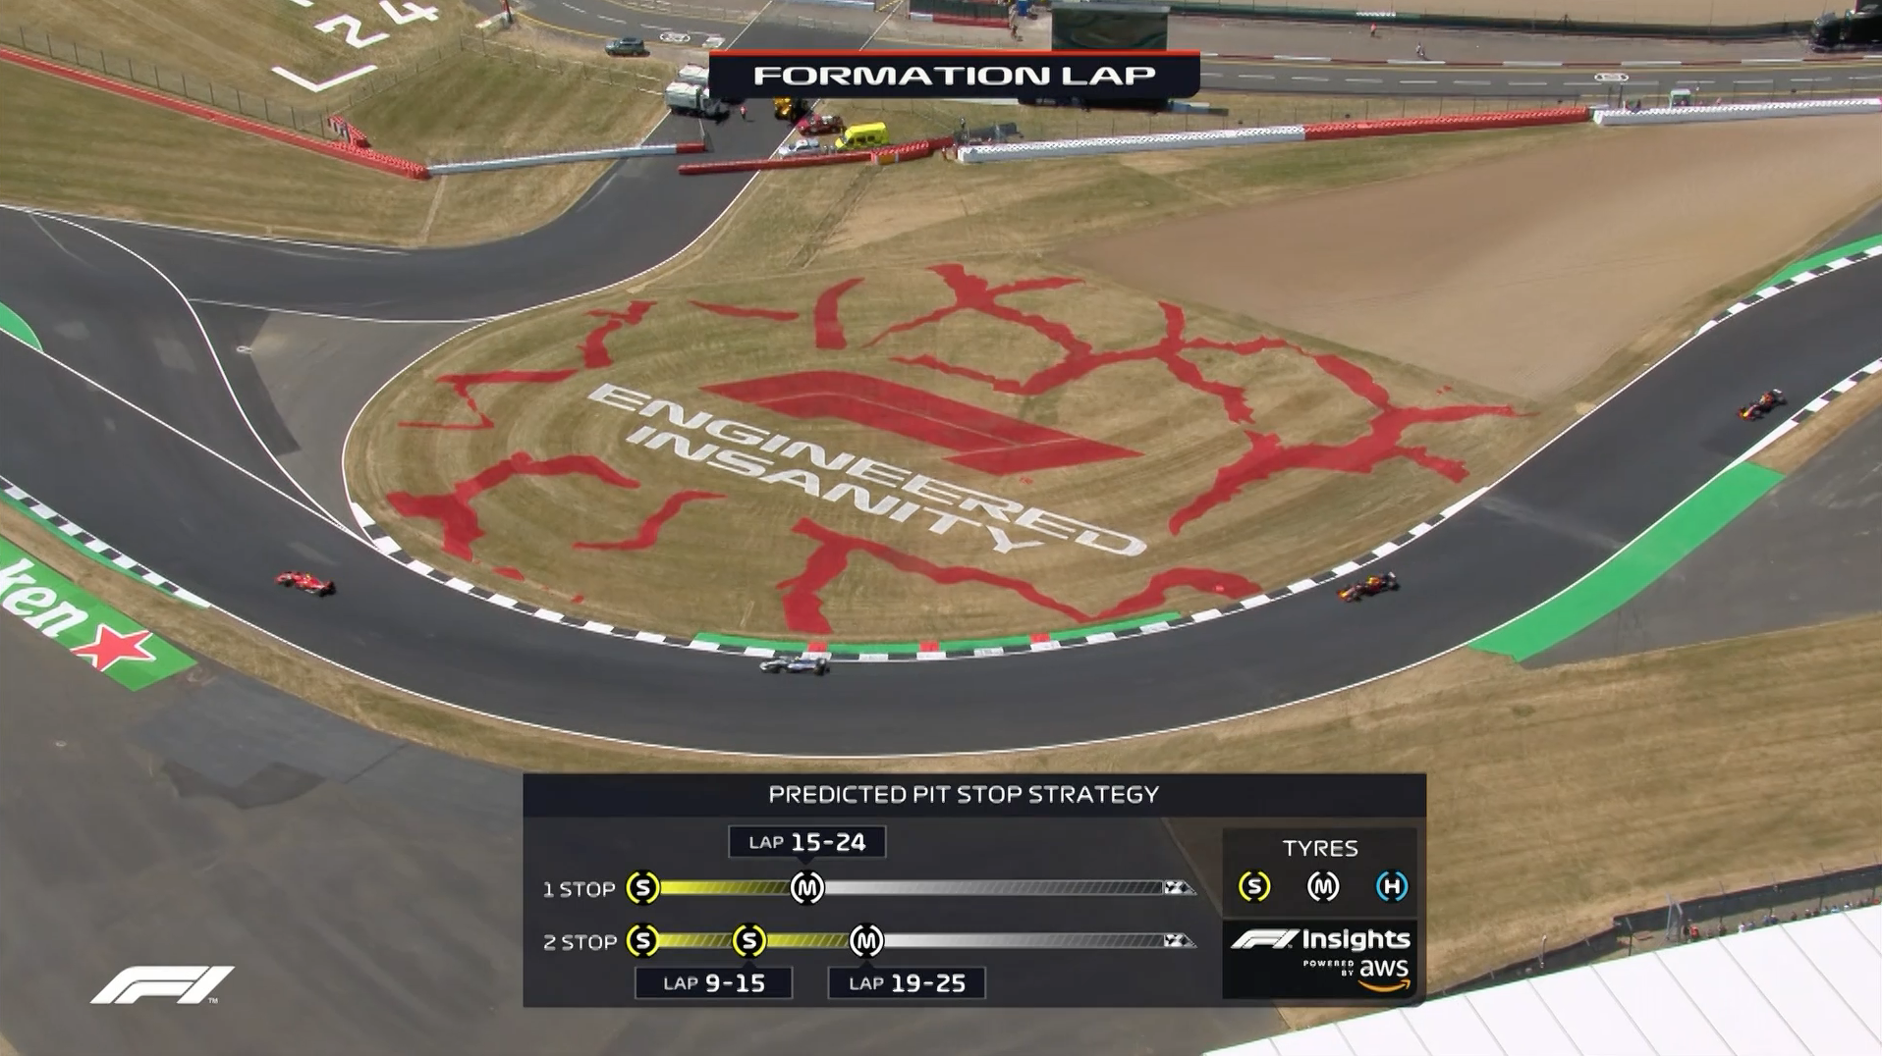


AWS powered insights integrated into TV world-feed
Increased aerodynamic simulation workload for next set of rules proposals
Digital archive of F1 history
Other applications being explored…

Slide 62

AWS Executive Leadership Series (Friday/Saturday/Sunday) events held by AWS at several F1 races
F1 technology sets the context for executive sharing of ideas, stories and experiences
AWS/F1 projects will be featured as they are developed

Slide 63
What can enterprises learn from the AWS + F1 partnership?
Use of analytics and AI to leverage large volumes of data and real-time streams
Continuous improvement in a competitive setting
Highly critical global logistics and reliable operations
Real-time strategic decision making
Building winning teams

Slide 64
Thank You
Adrian Cockcroft
Formula 1® images © Formula One World Championship Limited 2018
The F1 FORMULA 1 logo, F1 logo, F1, FORMULA 1, FIA FORMULA ONE WORLD CHAMPIONSHIP, GRAND PRIX and related marks are trade marks of Formula One Licensing BV, a Formula 1 company. All rights reserved.

